Slide 1
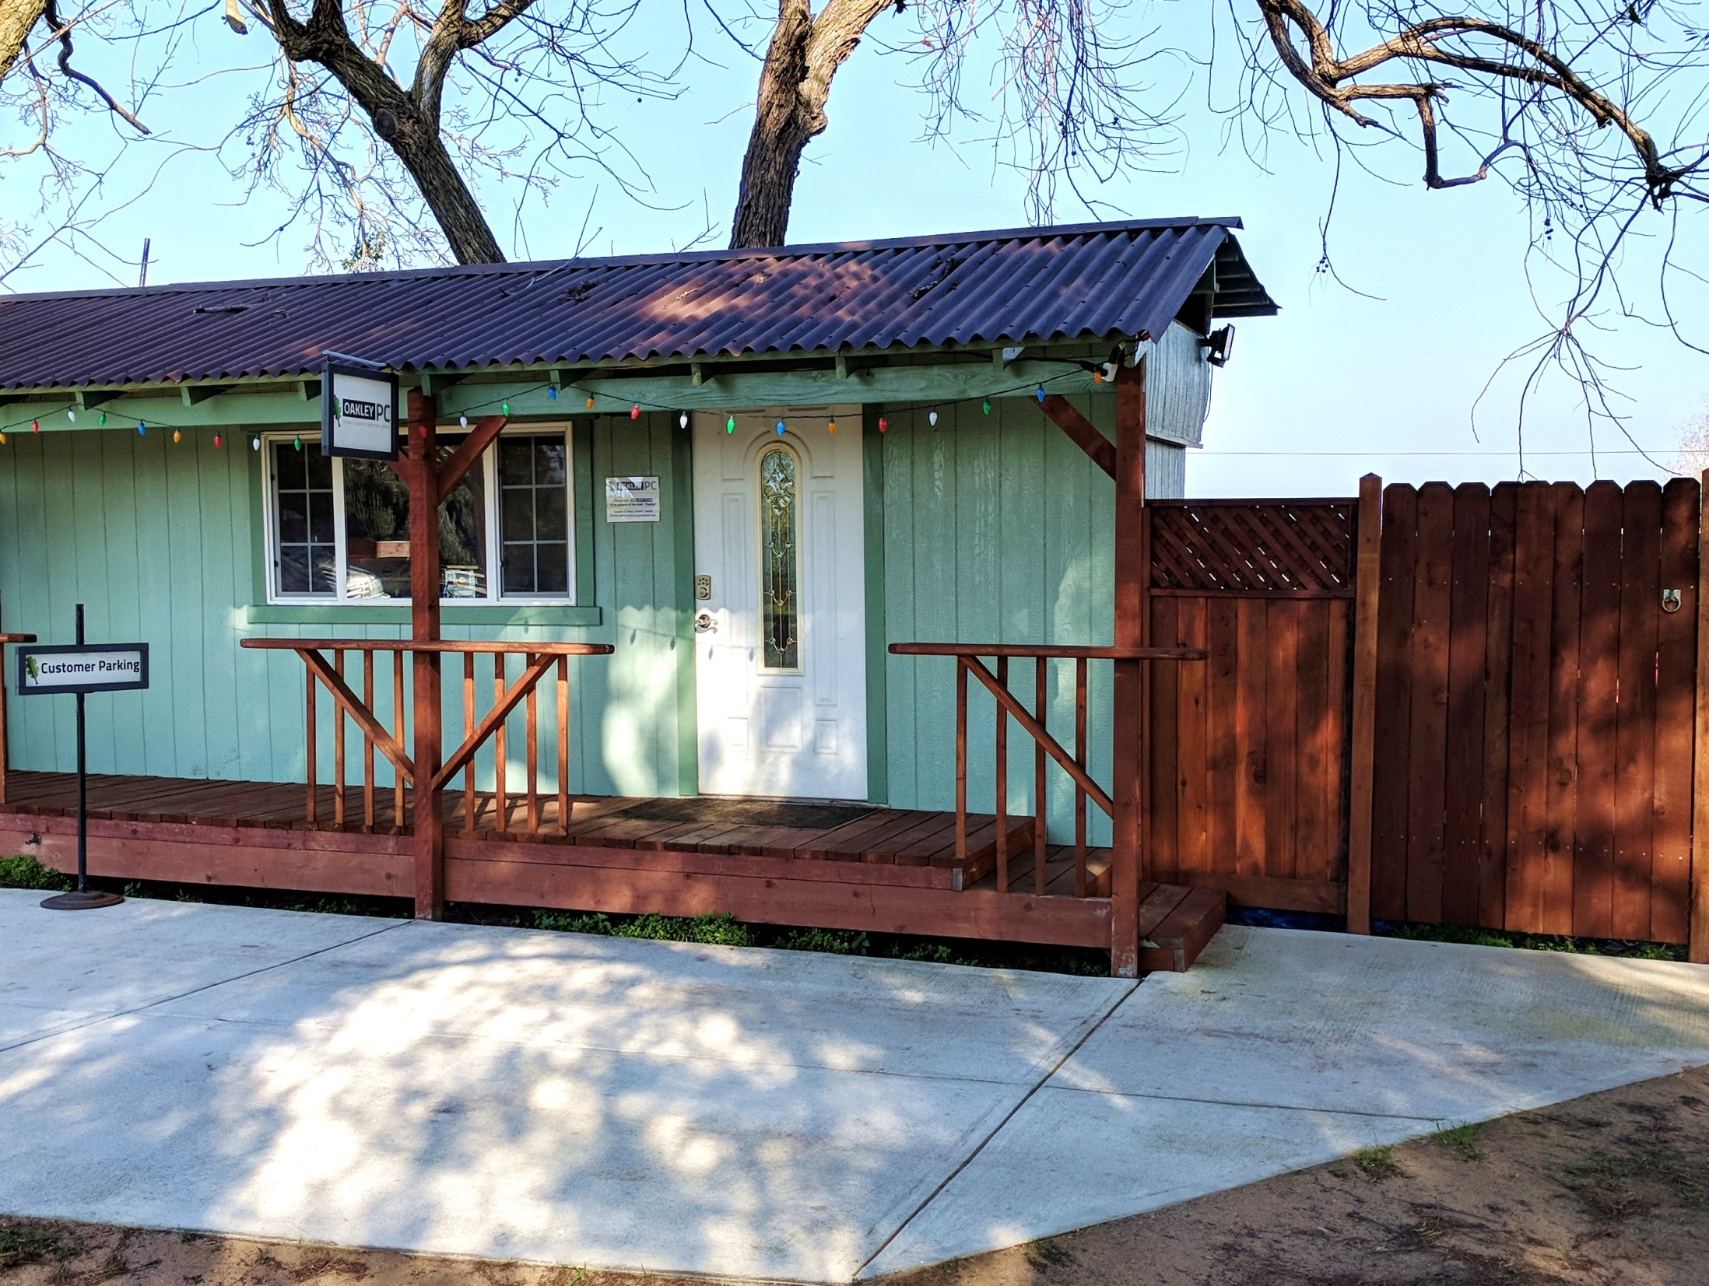


Slide 2
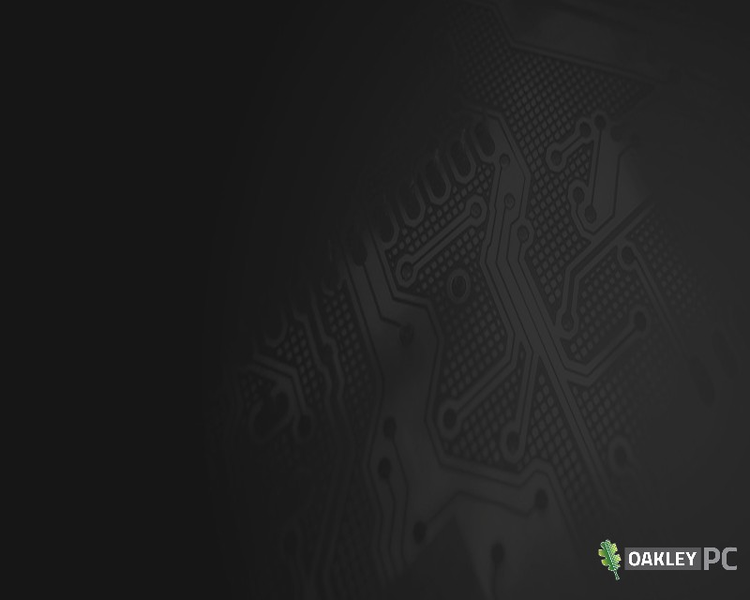
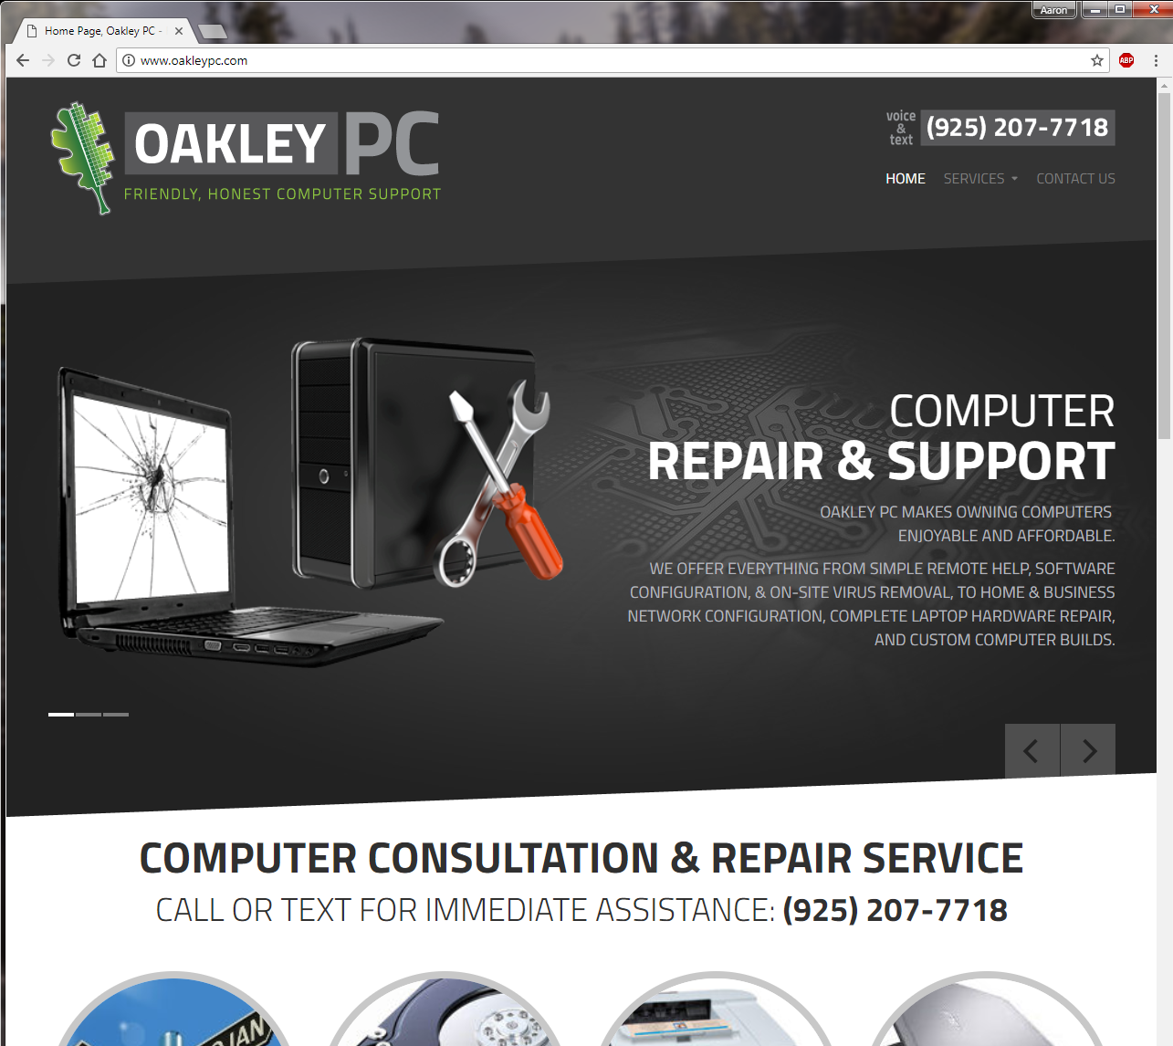

Slide 3
State of Computers: 2019
• Current threat trends
• Historical hardware performance
• Screen technologies, good or bad?
• Not so smart phones

Slide 4
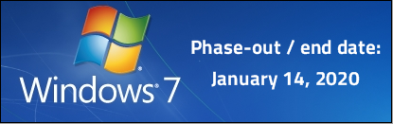

Current threat trends
• Windows “licensing” phone calls
• Chrome extensions
• MSE > Windows Defender > Windows Defender Security Center
• Malwarebytes

Slide 5
State of Computers: 2019
• Current threat trends
• Historical hardware performance
• Screen technologies, good or bad?
• Not so smart phones

Slide 6
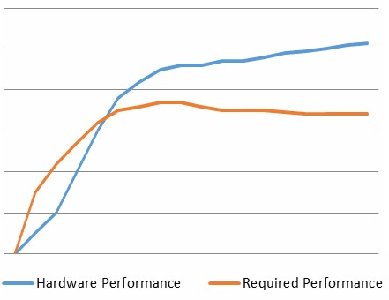
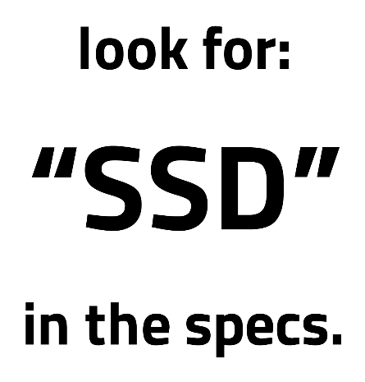
Historical hardware performance
• Any good brand PC with a list-price > $500
will be enough for 99% of users.

Slide 7
State of Computers: 2019
• Current threat trends
• Historical hardware performance
• Screen technologies, good or bad?
• Not so smart phones

Slide 8
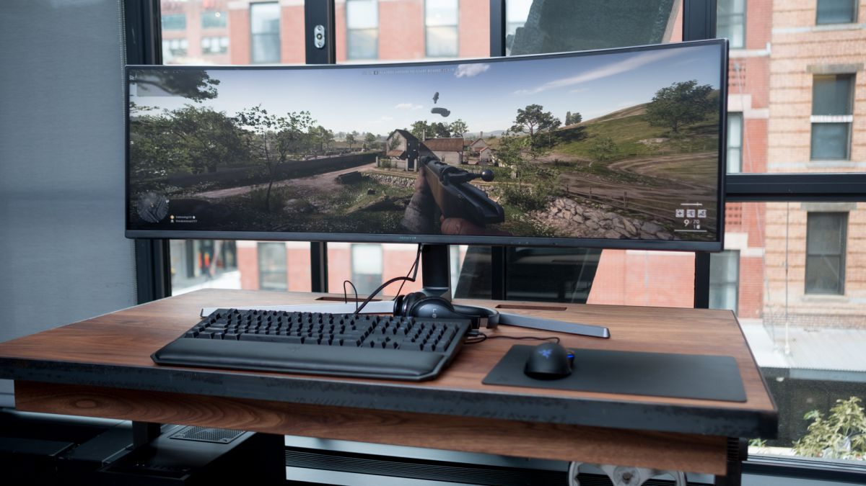
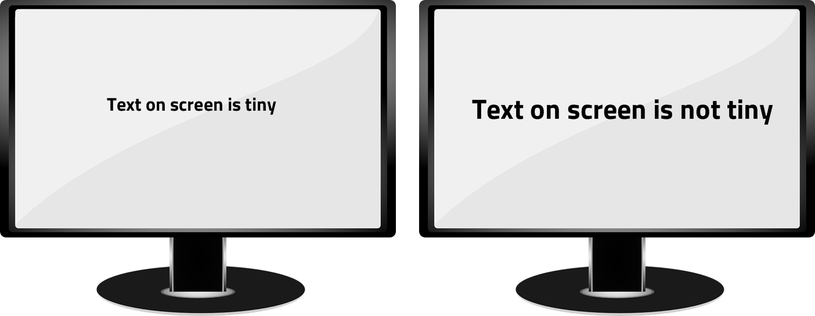
Screen technologies, good or bad?
• Glossy, touchscreen, and 4K, oh my!
- Glossy fancy looking screens have high glare.
- Touchscreens are usually glossy, and always ~4x the cost to replace if broken.
- 4K/high resolution screens, if not equally larger, make everything tiny:

Slide 9
State of Computers: 2019
• Current threat trends
• Historical hardware performance
• Screen technologies, good or bad?
• Not so smart phones

Slide 10
Not so smart phones
• The number one issue with smart phones & PCs, is getting pictures from the phone onto a PC. There are three main ways:
1) The “basic way” is to plug your phone into your PC and it magically & automatically copies or moves your pictures…
2) The “cloud” way is to have Google Drive, or iCloud installed on your PC, and paid for…
3) My way: Configure an app to move your pictures to your PC over your wi-fi every time you walk through the door…

Slide 11
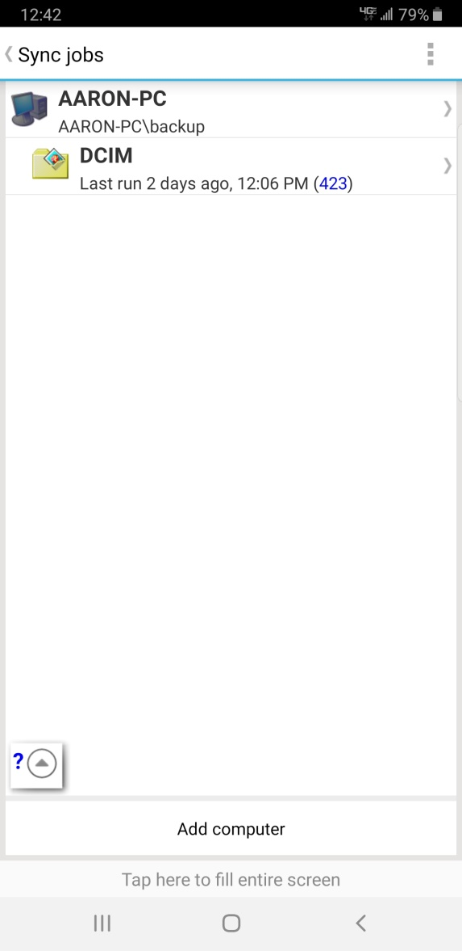
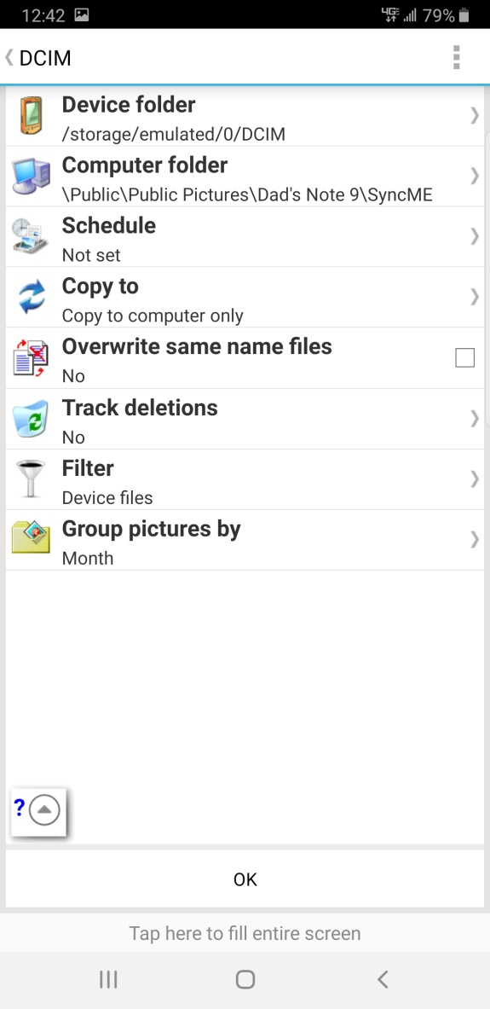
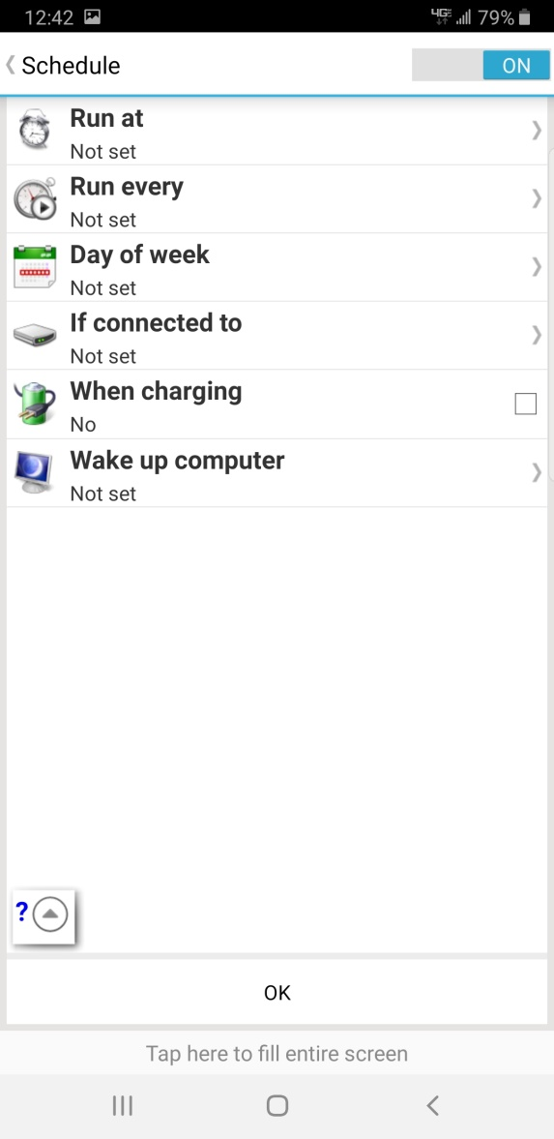
Android App: SyncME Wireless

Slide 12
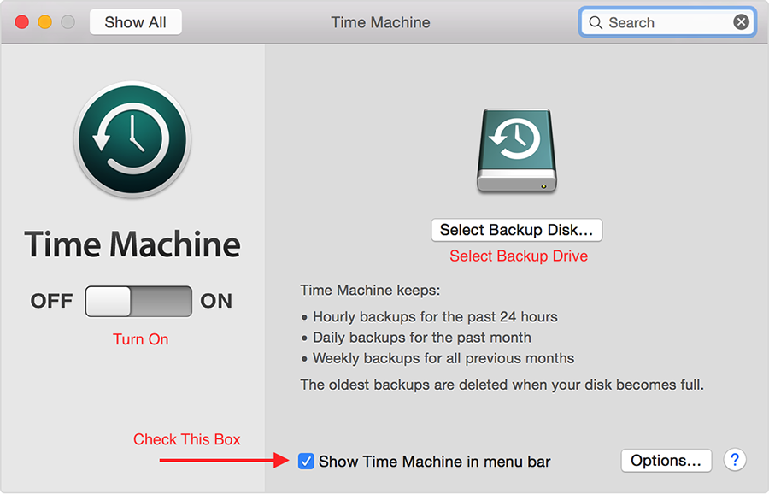
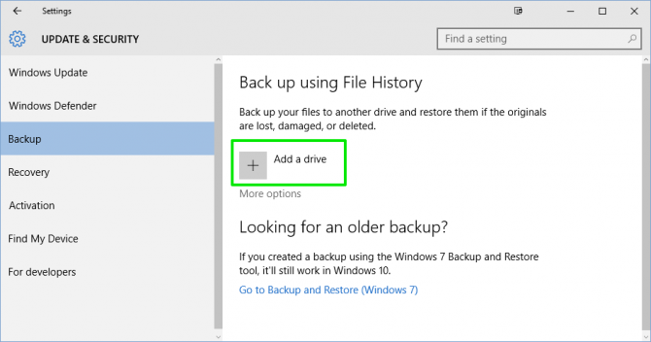
Quick Tip:
• How to easily backup:
- Microsoft: “File History”
- Apple: “Time Machine”

Slide 13


