Slide 1
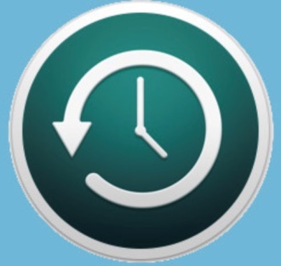

Why Backup?
Presented by Jim Bush
02/13/2020
(JimBushWhack@yahoo.com)

Slide 2
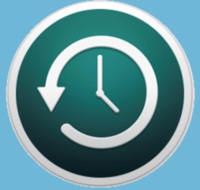
Introduction
Many of us have had someone ask us, “Did you take a backup?”, referring to making a backup copy of the photos, documents and other files on our computer. But how many of us heed this warning and perform a backup that can safe guard our most important files? Tonight, I will show you how taking a backup saved me from losing all the files on this laptop.

Slide 3

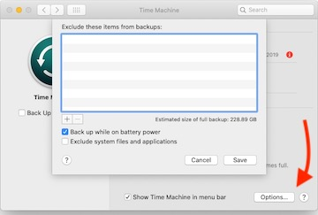
For Best Results, Take a Full Time Machine Backup Prior to Upgrade
Select a Backup Disk that has no other Backups from this Computer.
Go to System Preferences and select Time Machine.
Make sure “Time Machine in menu bar” is checked then select Options.
Make sure that there are no folders or files excluded and uncheck “Exclude system files and applications”.
Click time Machine icon in upper right hand corner menu bar.
Click “Backup Now” to start the full backup.

Slide 4
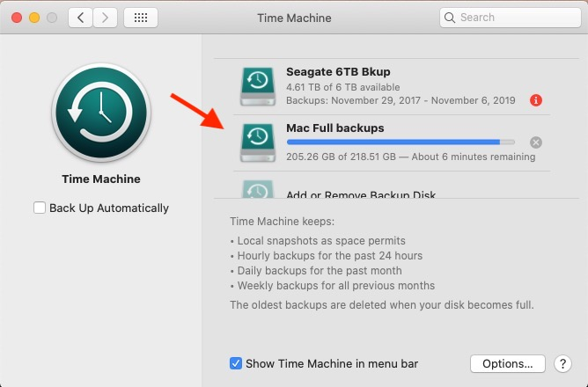
Full Backup Progress Prior to Upgrading to MacOS Catalina
Backing up to an external disk named Mac Full backups.
Note that Backup Automatically is unchecked.
Full backup is nearing completion.

Slide 5
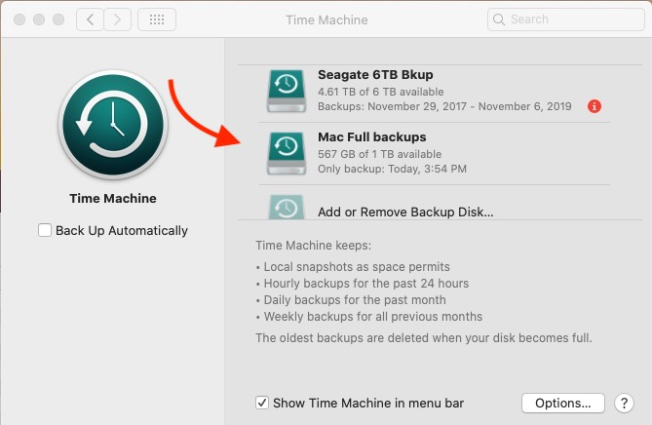
Backup Complete. Start Catalina Upgrade.
Done with full backup. Start Catalina upgrade by going to System Preferences->Software Update and clicking on the Download update block.
Allow 8.1GB update to download.

Slide 6
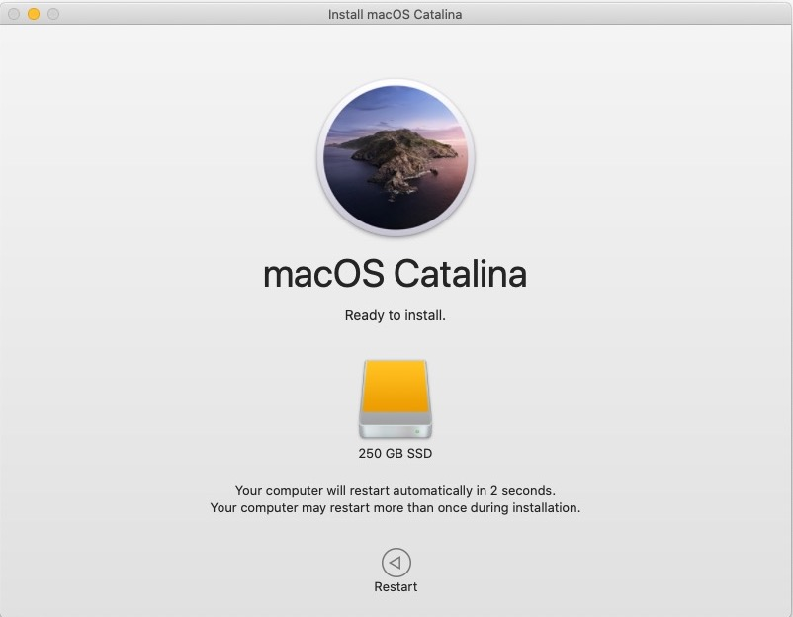
Begin Catalina Installation
Upgrade should start automatically after download complete. If not or if you want to do the upgrade later, go to Applications and you will find the Catalina installation there and named Install macOS Catalina.
For this illustration, I am using a 250 GB external SSD, since I did not get pics of original upgrade.

Slide 7
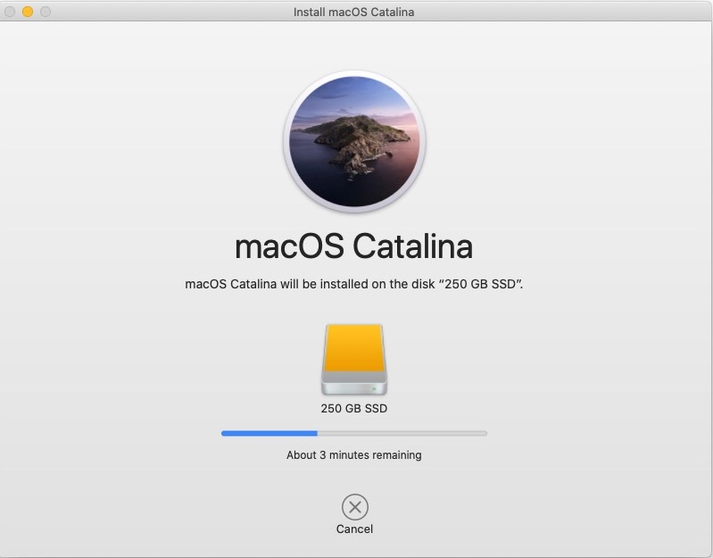
Catalina Installation Continues
After about 3 hours has elapsed, installation is almost complete.

Slide 8
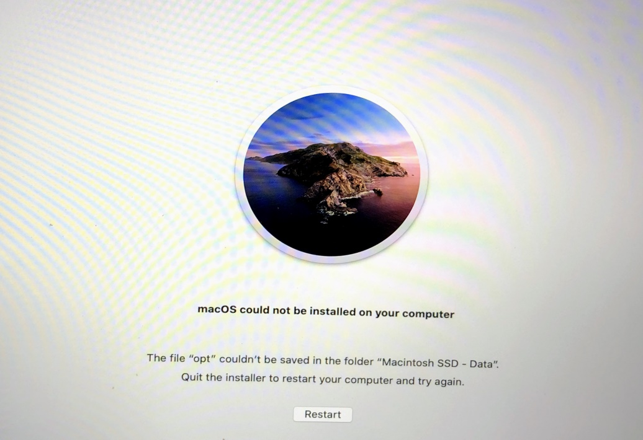
First Sign of a Problem With Installation
Saw this screen when almost done with installation. Tried restarting several times, but always ended up at same place.
Determined that I would need to institute recovery procedures to save my data.
Tried booting from recovery partition, but it was also gone.
Downloaded Catalina on my other Mac and used “Install Disk Creator” script to create bootable thumb drive.

Slide 9
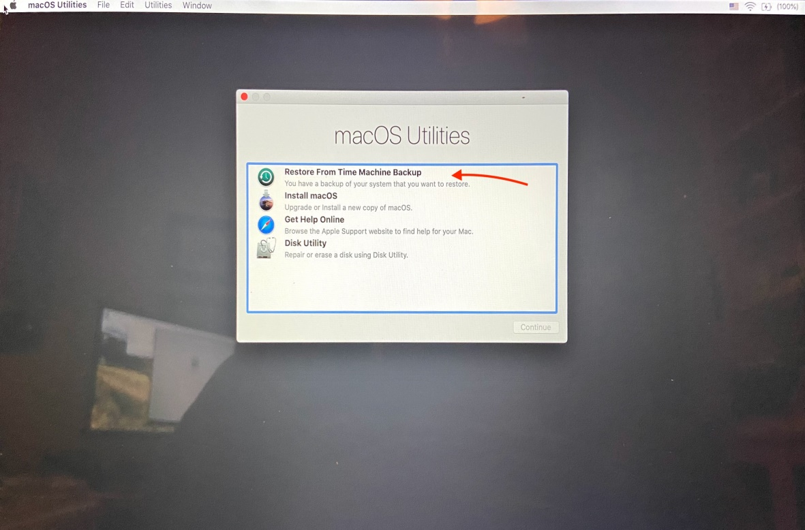
Begin Recovery by Booting From Recovery Partition or Thumb Drive
Would normally boot from recovery partition by restarting while holding down the Command + r keys.
In my case, I made and booted from a bootable thumb drive because Recovery Partition had also been wiped out.
Select the Restore from backup option when you see the Utilities menu.
Plug in the “Mac Full Backups” disk to a USB port prior to booting .

Slide 10
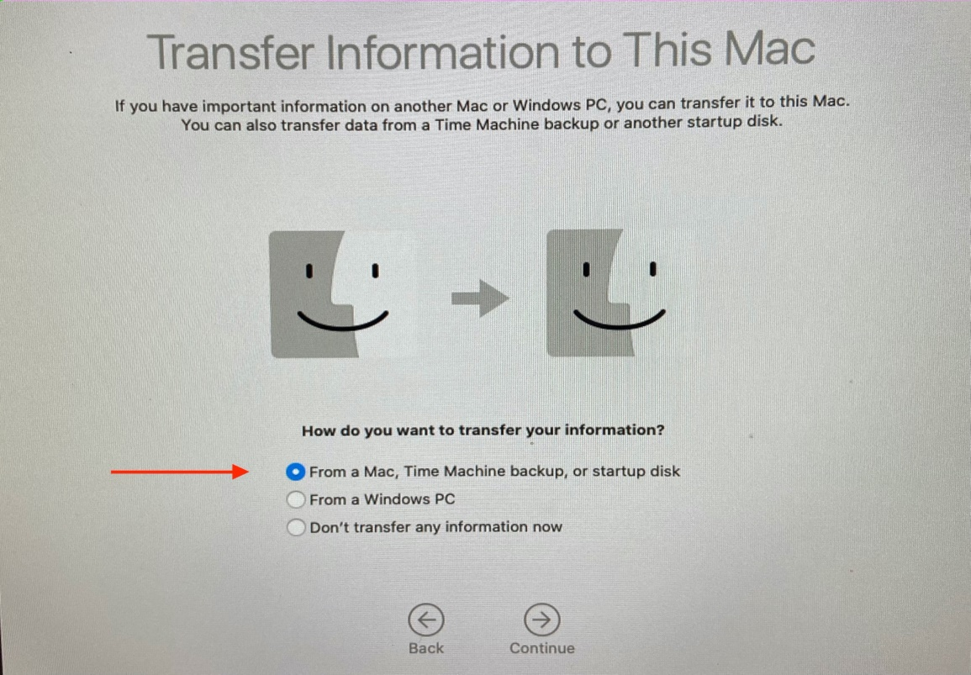
Begin Migration (i.e. Restore) Process
Note that Restore from Backup brings up the Migration Assistant which may look familiar if you have ever migrated your files from an older Mac to a new one. Same code.
Select the “From a Mac, Time Machine Backup or startup disk” option.

Slide 11
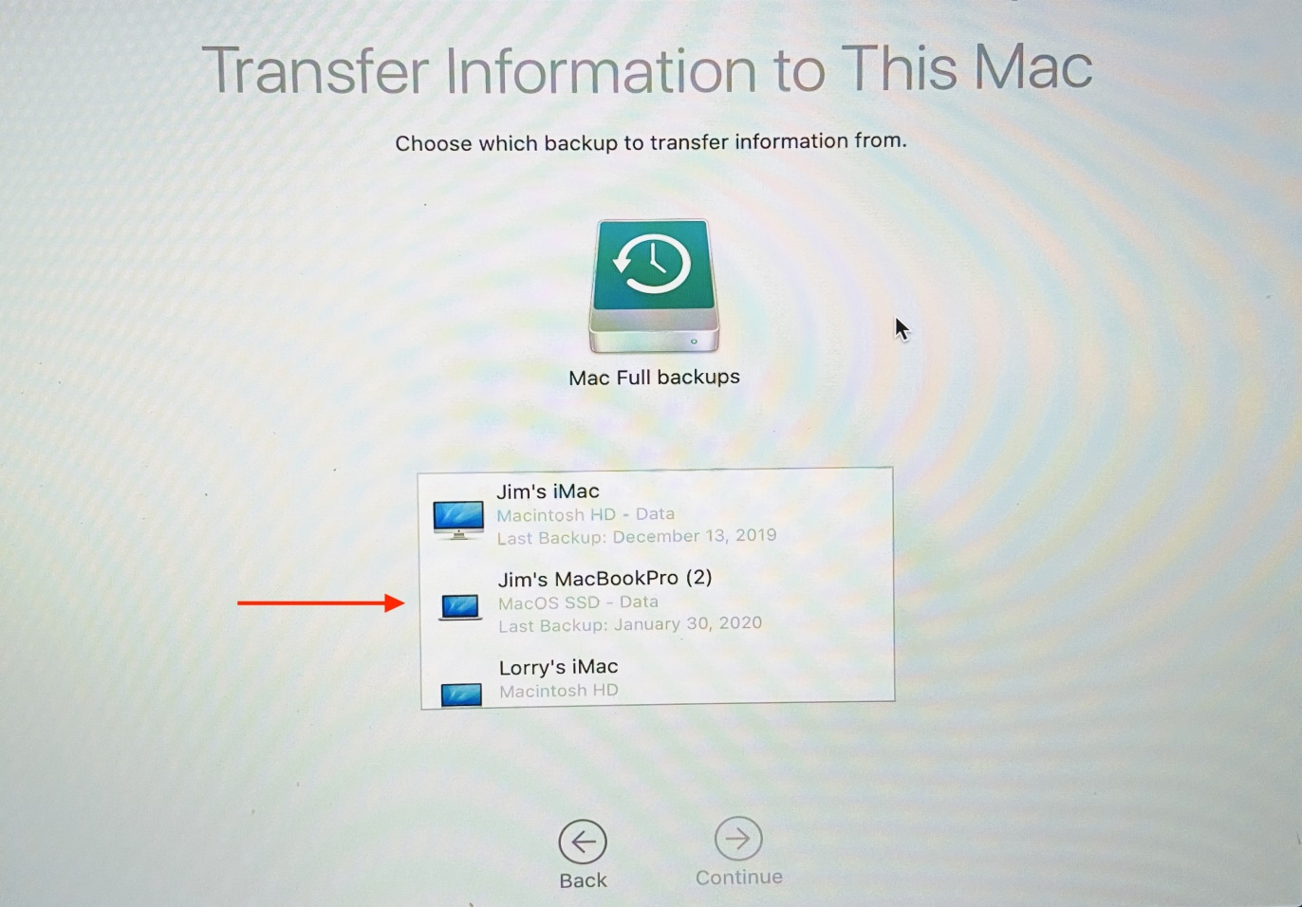
Choose Backup Source
This backup disk contains full backups from all 3 of my Macintosh computers.
Select Jim’s MacBookPro (2) and then continue.

Slide 12
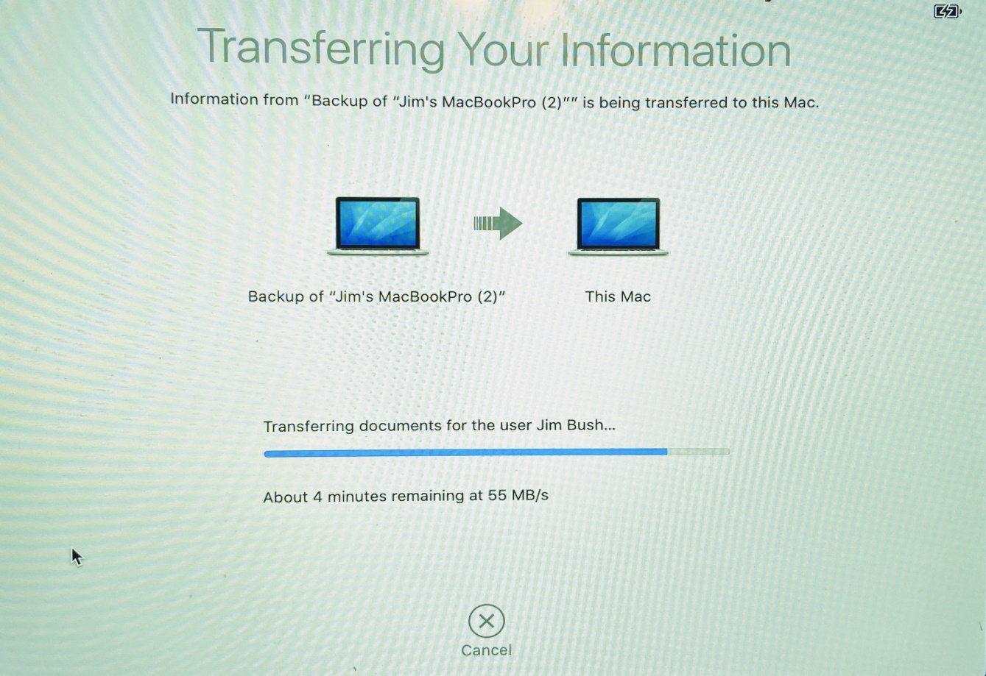
Restoration From Backup Progress
Restore or Migration is almost done.

Slide 13
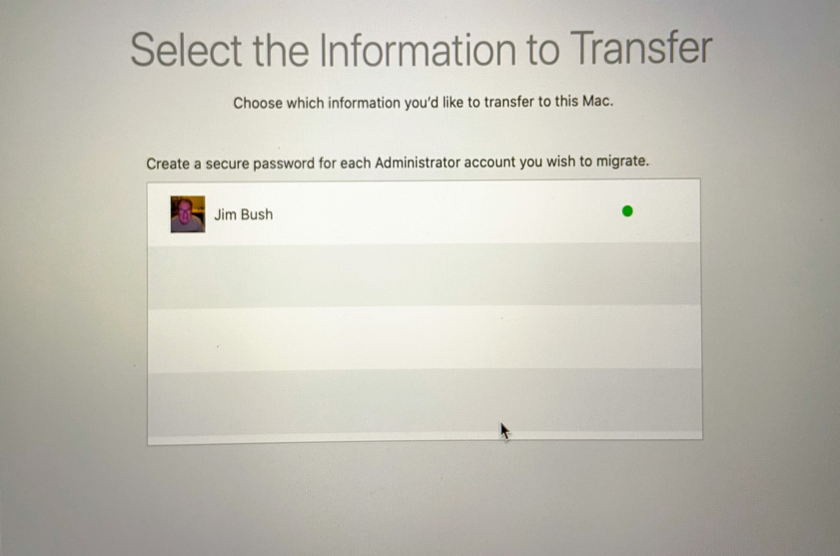
Selection of Account(s) to Restore
Restored only my account, the applications folder and settings on the external 250GB SSD. In the original recovery scenario, I also installed my wife’s folder as well.

Slide 14
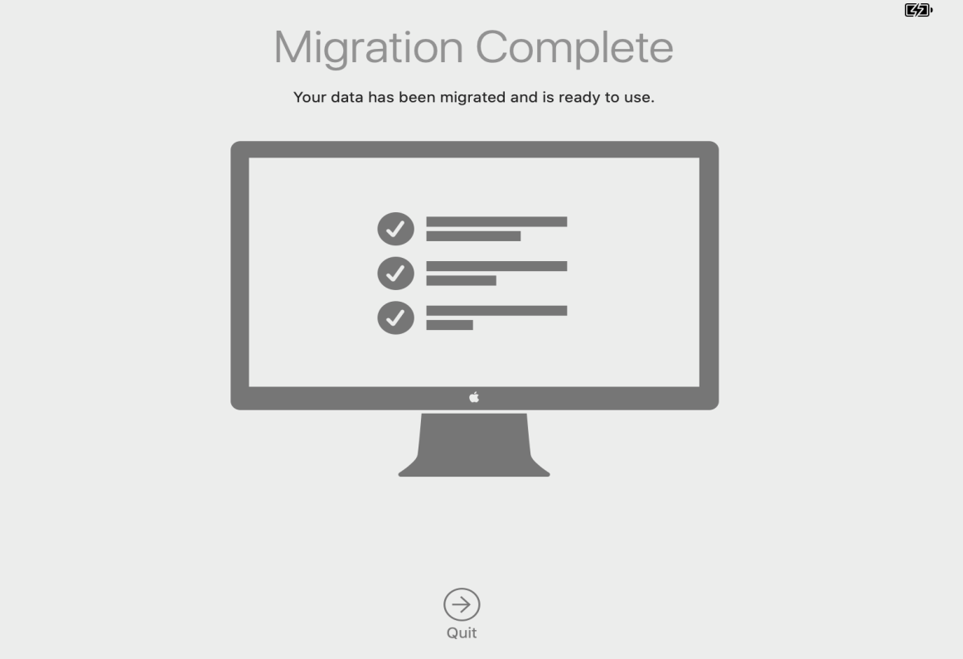
Migration (i.e. Restore) Complete
Upon quitting out of this screen, machine will reboot onto the freshly installed disk.
In this case it will be the 250 GB external SSD.
After rebooting, I looked for and found the apparently corrupted file “opt” under the root folder of the boot disk and deleted it.

