Slide 1
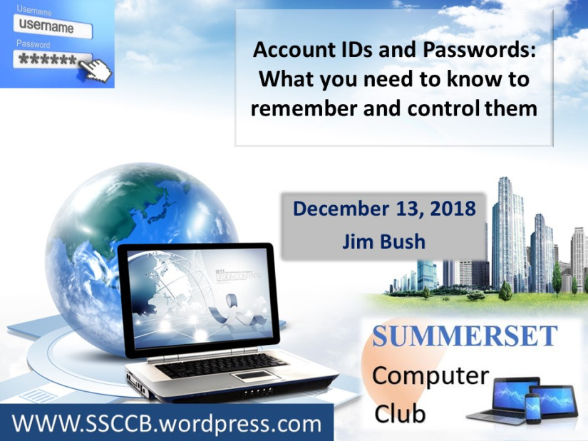

Using Password Managers
(and why you should)
February 14, 2018
Mike Quinn

Slide 2



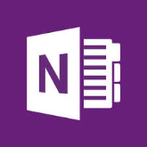


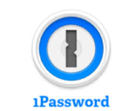


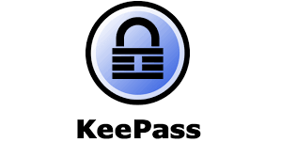
Remembering Passwords
Memory
Paper
Notepad/Wordpad
OneNote/Evernote
Password Manager
Notes:
Memory – you know why this is bad
Paper – can get lost, stolen, not encrypted
Notepad/Wordpad – can get deleted, hard to share when it changes, not encrypted
OneNote/Evernote – workable solution if you use encryption. Evernote can unencrypt your docs, so I don’t recommend it.
Password manager – saved in cloud, easy to share, encrypted

Slide 3
Things to Consider
Ease of Use (for you)
  If it’s not easy, you won’t use it
  Sharing with spouse, kids(?)
Do you travel?
  Do you need passwords when you’re away from home?
When you’re gone
  How do your heirs get to your important accounts?

Slide 4
Platform support
Windows
  Application support - Lastpass
MacOS
  All managers support MacOS browsers
IoS
  Need IoS 12 for good support
Android
  Support on Android for apps is a bit clunky
  Bitwarden has worked best for me.
Linux
  Basic browser support

Slide 5
Common Features
Store passwords, user names & URLs in cloud
Various ways to login
Groups/Folders to sort websites
Import/Export to various formats
Password Generator
2FA authentication (sometimes needs $$$)
Some kind of Password Analysis
Notes:
Encrypted and decrypted locally
Auto-logon, Auto-fill, “icon” choice in username/password fields of website, copy/paste of user name and password
Don’t actually recommend auto-logon or auto-fill – 2 people with different logins causes things to act differently
When there’s 1 login vs 2 (because with 2 logins, you really don’t want auto-logon to happen)
The icon allows you to choose which logon to use for the site.
Import and Export good for doing your own analysis, or for moving passwords from 1 product to another.
Bitwarden is the odd man – it’s exports aren’t imported well by others (you need to edit the .csv file).
2FA authentication can use a number of features – yubikey (hardware), authy or google authenticator (software)

Slide 6
A Digression – 2FA
Two Factor Authentication – use it for important (i.e. money) accounts
Something you have + something you know
Keep them separate from each other
Typically “Authy” or “Google Authenticator” app (TOTP = Time-based One Time Password) or hardware key like Yubikey

Slide 7



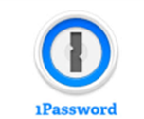


The Major Players
Bitwarden
LastPass
Dashlane
1Password
-----------------------------------------------------------
Keepass
Roboform

Slide 8

Bitwarden
  Free
    $10/year for extras
  Open Source/peer reviewed
  TOTP support
  Notes
  2FA
Notes:
Bitwarden extras – Yubikey, 1GB storage, TOTP authenticator key storage, health & hygiene reports, attach files to websites
Put it on a USB drive and tell your successor where to find the drive (or give it to them if you trust them)
Don’t use a safe deposit box because of the hassle of probate for your successors to get to it.
TOTP = Time-based One Time Password (Authy, Google Authenticator). You normally don’t want to have your password manager handle
TOTP because that’s all your eggs in one basket – if your laptop gets stolen and hacked – they can log into your 2FA websites. Of course, if it’s
Your phone that’s stolen, your in trouble because it typically has your 2FA app on it as well.

Slide 9

1Password
  $36 or $60/year
  Aggressive 30 day trial (take your CC # up front)
  “Emergency access” based on secondary password
  payment cards, notes, identities
  TOTP support
Notes:
Keep “Emergency access” info on USB stick
Don’t use TOTP support – puts all your eggs in one basket and makes your 2FA less secure.

Slide 10

LastPass
  Free or $36 or $48/year
  Emergency Access (time-based)
  Store Digital Records
  Addresses, Notes, payment cards, bank accounts
Notes:
You can setup an lastpass user that can request access to your account. They must have a lastpass account.
Personally, I don’t use online forms or payment cards or bank accounts. Too much info in 1 place makes it easier
To hack. Also, slows you down just a little bit on those impulse spends ☺

Slide 11

Dashlane
  Free or $60 or $120/year
  Password analysis
  Dark web monitoring
  Secure VPN
  Notes, Identities, Receipts, Payment Accounts
  Emergency Access (Time-based)
Notes:
Free = 50 passwords and only autofill
$120 = credit monitoring, identity theft insurance, and identity restoration support
If you want secure VPN, try privateinternetaccess.com – very fast, keeps no log information
Emergency access requires at least a free dashlane account.

Slide 12
Demo

